Slide 1


FASTER WEBSITES WITH
WEB PAGE TEST
❍

Slide 2
What We’ll Cover
This should only take a few hours.
How WebPageTest Works
The basic concept of synthetic testing and architecture overview.
Advanced Usage
Dive into the deep end and put WebPageTest through its paces.
1st
3rd
What
How
Basics
Advanced
2nd
4th
What is WebPageTest?
What WebPageTest is and why it’s useful.
Basic Usage
How to configure and analyze a basic test.

Slide 3
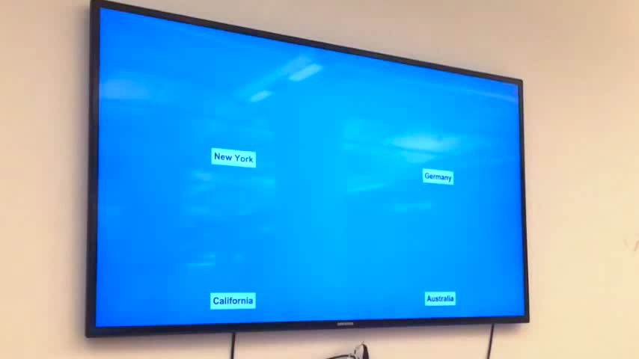
What is WebPageTest?
Around the world, around the world. Around the world, around the world. Now Daft Punk is stuck in your head.
Yey Murica!
Poor Australians :(

Slide 4

What is WebPageTest?
It’s a test for a web page. Duh.

WebPagetest is this one
Real User
Monitoring
How fast is this page?
Synthetic
Testing
How do I make this page faster?
Notes:
Highly instrumented

Slide 5


What is WebPageTest?
Whoa… That’s some cool animation.
2005
2010
Open Sourced under BSD
Source moved to GitHub


Began life during the dial up era
Lead developer hired by Google
2008
2011

Slide 6

What is WebPageTest?
It’s got a face only a mother could love.
“
So, unfortunately, yeah, I’m not a UI designer so everything is a tab or a checkbox and it’s all hidden somewhere.
- Pat Meenan
”


Slide 7












How WebPageTest Works
Finally, this guy gets to some real content!

WPT
WWW

Slide 8
How WebPageTest Works
Is every slide going to have one of these lame jokes?
❒

Slide 9
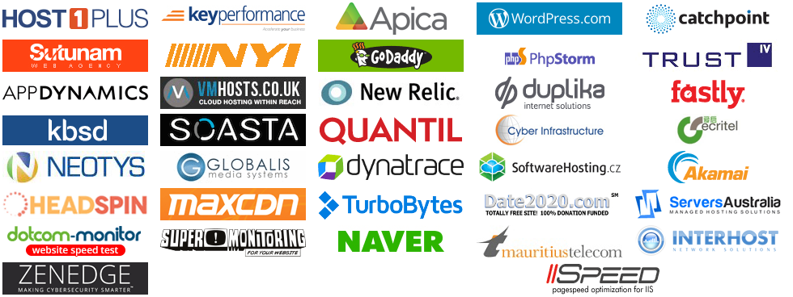
How WebPageTest Works
There are 10 kinds of people in the world. Those that understand binary, and those that don’t.

Slide 10
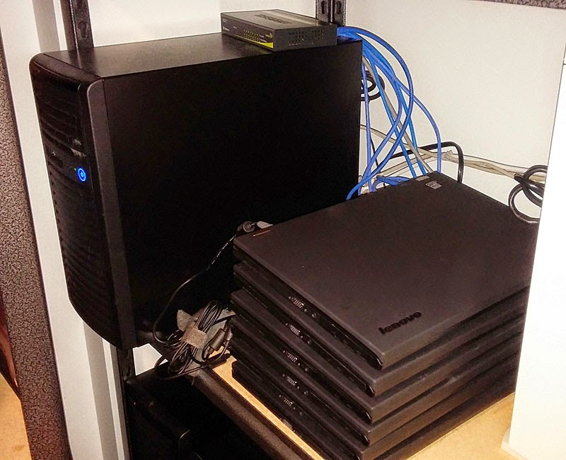
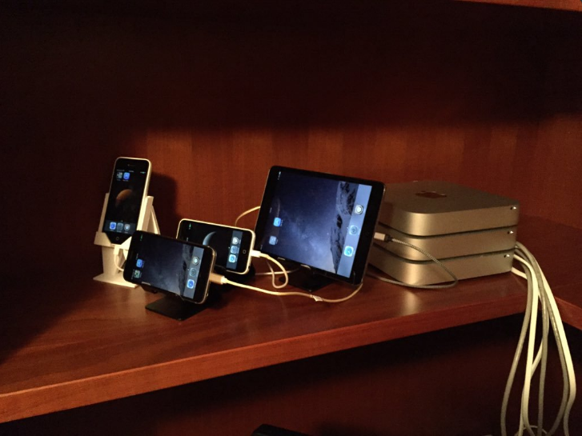
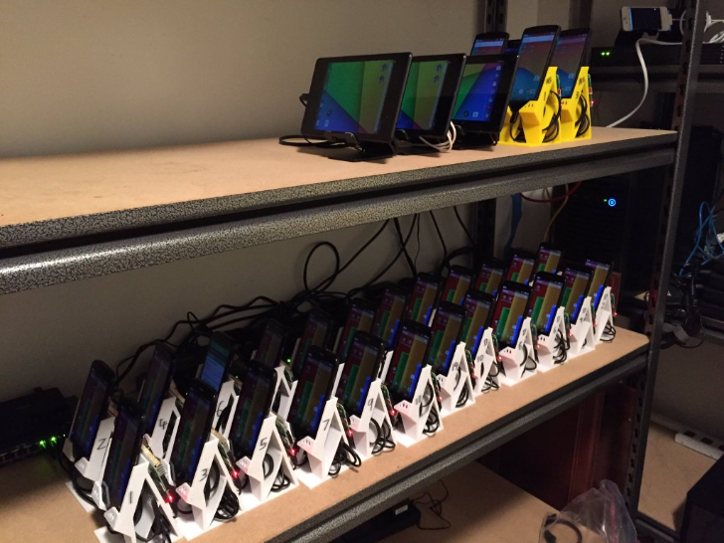
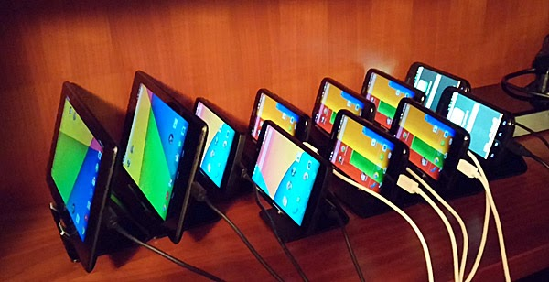
How WebPageTest Works
This color is #BADA55.

Slide 11
Basic Usage
Fun Fact: The word “algorithm” was coined in tribute to Al Gore’s contribution to computer science.

✶

#
Location
Browser
Test Count
URL


Slide 12
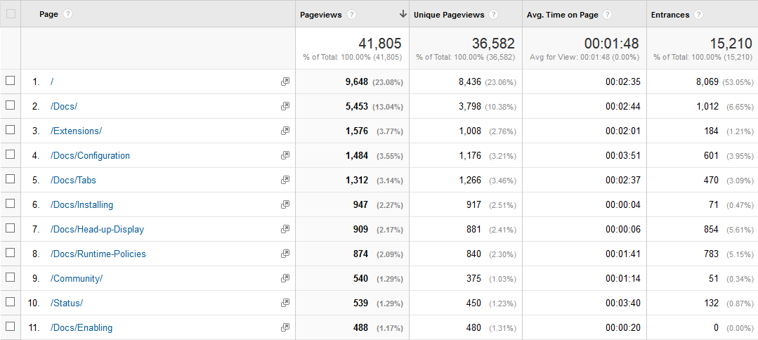
Basic Usage : URL
Two sausages are in a pan. One says “It’s hot in here”. The other says “You can talk!?” Yes, this joke is certifiably bad. – Credit: James Chambers

Slide 13

Basic Usage : Location
["hip", "hip"] // first one to figure this one out and shout it out loud wins

Slide 14
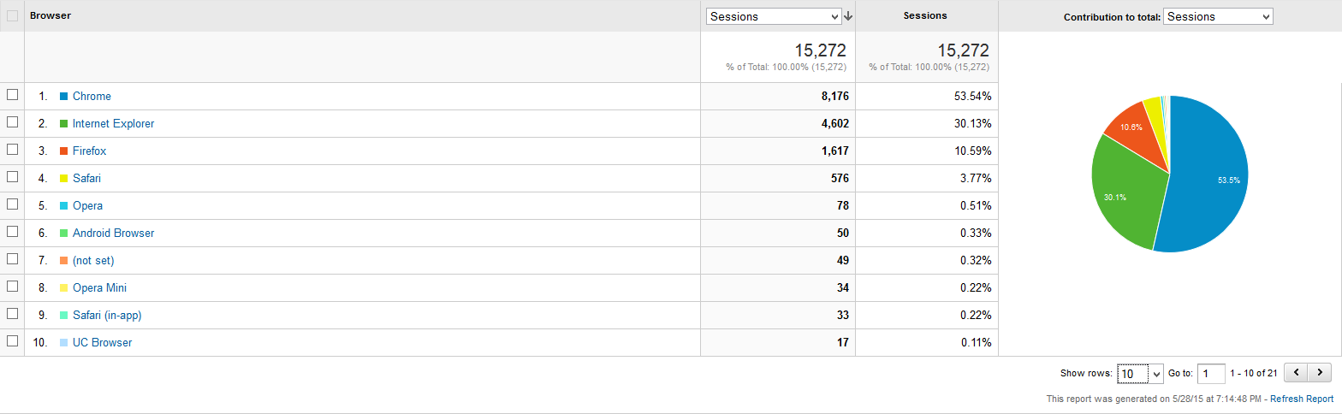
Basic Usage : Browser
Ugh. I hate shaving. Beards should have been designed as an opt-in feature.

Slide 15
Basic Usage : Test Count
1f u c4n r34d th1s u r34lly n33d t0 g0 out51d3.
Test
1
2
3
1st

1st

1st

4
5
6
1st

1st

1st

7
8
9
1st

1st

1st



Slide 16
Advanced Usage
Something witty goes here.
Custom Metrics


Security


Automated Scripting
API

Slide 17
Advanced Usage : Custom Metrics
To understand what recursion is, you must first understand recursion.
[action-execution-time]
var body = document.body, result = -1;
for(var i = body.childNodes.length-1; i >= 0; i--) {
if(body.childNodes[i].nodeType === 8) {
result = JSON.parse(body.childNodes[i].nodeValue).action;
break;
}
}
return result;


Slide 18
Advanced Usage : Automated Scripting
Oct 31 == Dec 25, so Halloween is Christmas.
// navigate to start page
logData 0
navigate http://mascots-staging.azurewebsites.net/
// input search
setValue name=q bo
logData 1
submitForm name=search
"
"
"
"
"
"


Slide 19



Advanced Usage : Security
Don’t let Troy Hunt see this slide!
internal

WPT
FIREWALL
WWW
NGROK


Slide 20

Advanced Usage : API
These jokes aren’t bad. They’re in “beta”.


Slide 21


Thanks! Questions?
Send complaints to: trash@molnar.com

Twitter
@nikmd23
·
Blog
nikcodes.com
Pluralsight too
help my royalties!
http://bit.ly/faster-with-wpt

